Slide 1


Mining Process and Mining Pools
Network Difficulty, Mining Mechanics,
CPU/GPU and ASIC Mining, Solo vs. Pool Mining
Simeon Mandazhiev
Assistant Trainer
Academy School of Blockchain
http://kingsland.academy

Slide 2

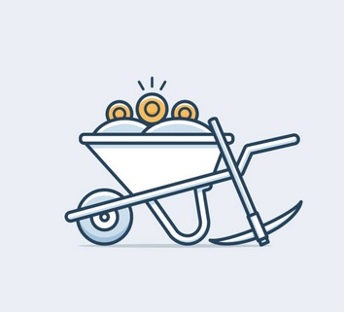
Table of Contents
Understanding Mining
Mining process, network difficulty
Exercise: Write a Simple Miner
Mining Methods
Solo mining vs. pool mining
Mining farms
Exercise: Mine Ethereum in a Pool
Mining equipment CPU, GPU, ASICs
Exercise: What to Mine?

Slide 3
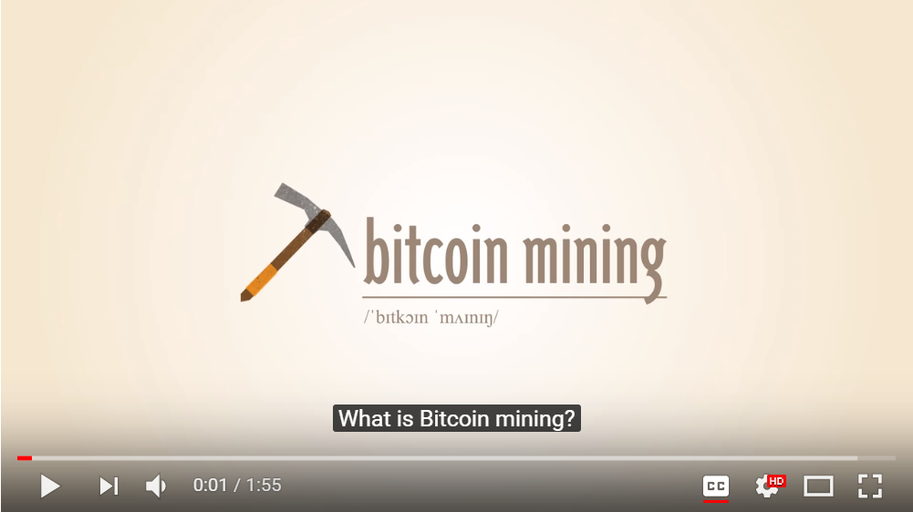
What is Bitcoin Mining?
https://www.youtube.com/watch?v=GmOzih6I1zs

Slide 4
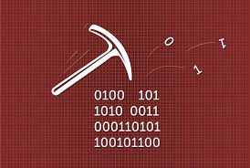
How Does a Cryptocoin Mining Work?
Mining is a part of the PoW consensus
Miners verifying transactions
They create new blocks
Miners get paid with fees and newly mined coins (through a coinbase transaction)
Proof of Stake networks do not perform mining
Instead, blocks are build by verifiers (not miners)

Slide 5
How Does the Bitcoin Mining Work?
A miner calculates SHA-256 on the block header
The only mutable element in the header is the nonce
The hash result must start with more zeroes than the target
Block “n” → Header n:
- Nonce (0)
- [hash(header(n-1))]
- Etc…
SHA 256
00dlks3nfolr0jdgf5h6h
Result
00dlks3nfolr0jdgf5h6h
Target
0000000dg4ghf54yhfhd67

Slide 6
How Does the Bitcoin Mining Work? (2)
The miner increments the nonce until a satisfying result is found
This may take a lot of time and hashing power!
Finally, the nonce is found and the hash meets the target
Block “n” → Header n:
- Nonce (128563)
- [hash(header(n-1))]
- Etc…
SHA 256
00000000jf8hf98h5h6r
Result
00000000jf8hf98h5h6r
Target
0000000dg4ghf54yhfhd67

Slide 7
How Does the Bitcoin Mining Work? (3)
Miners compete each other in order to find a correct nonce
Once a correct nonce is found
The lucky miner builds the next block
Broadcasts it for verification by the other miners in the network
Transaction fees + mining award are collected by the miner
The network validates the new block
Valid block → miners start mining the next block
Invalid block → miners continue mining the current block

Slide 8
Proof of Work Mining in the Blockchain
PoW mining process
Blockchain clients create and sign transactions
Blockchain Network
Selects the winning node (a lucky miner)
Blockchain Node #1
Blockchain Node #7
pending transactions
Transaction A
pending transactions
Transaction B
Blockchain Node #2
Validates the pending transactions and creates the next block
Transaction C
pending transactions
Transaction …
Next (New) Block
Propagate for validation
Transactions are sent to the network
confirmed transactions
Blockchain Node #...

Slide 9
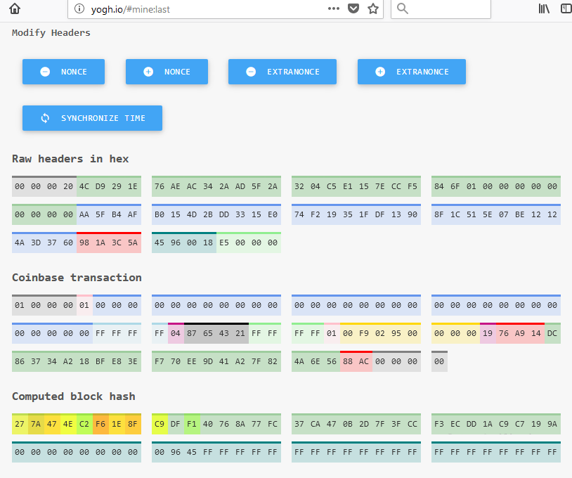
How Does Cryptocoin Mining Work?
Live Demo: http://yogh.io/#mine:last

Slide 10

Mining Rewards
Miner who mined the block receives coins from two streams:
The fees paid on the transactions
The new bitcoins created by the coinbase transaction

Slide 11

What is Network Difficulty?
The mining target is also called "network difficulty"
The difficulty is defined by the number of zeroes in the beginning
In Bitcoin system if more computational power is added to the network, system increases its difficulty
Target (Difficulty)
000dlks3nfolr0jdgf5h6h
Target (Difficulty)
000000gdjhfhj57kjytt9

Slide 12
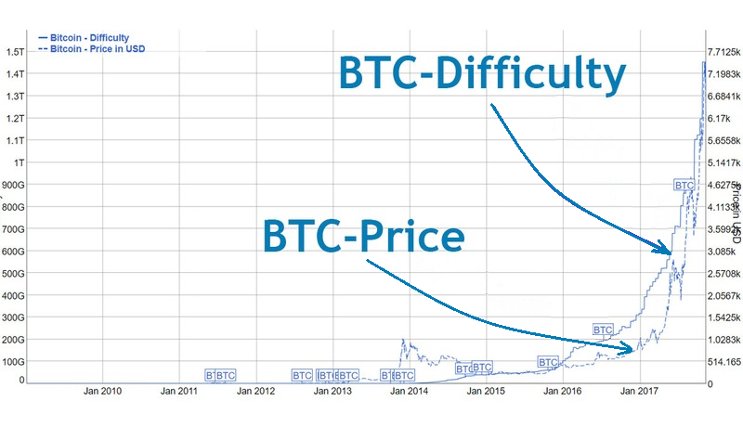
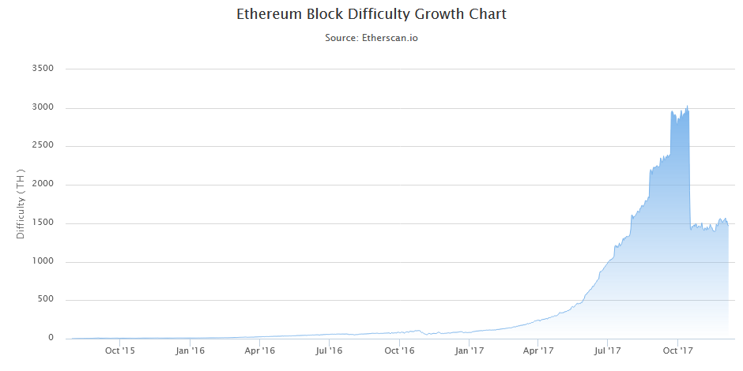


Cryptocurrency Difficulty Growth
Growing number of miners raises the network difficulty

Slide 13

Exercise: JS Blockchain + Miner
Blockchain in JavaScript
JavaScript Blockchain with Simple Miner

Slide 14
Implementing Mining: Block Structure
class Block {
constructor(index, timestamp, data, previousHash = '') {
this.index = index;
this.previousHash = previousHash;
this.timestamp = timestamp;
this.data = data;
this.hash = this.calculateHash();
this.nonce = 0;
}
Data is stored in the block (typically holds transactions)
Miners search for nonce to validate the block

Slide 15
Implementing Mining: Proof of Work
Search for more zeroes than difficulty
mineBlock(difficulty) {
while (this.hash.substring(0, difficulty) !==
Array(difficulty + 1).join("0")) {
this.nonce++;
this.hash = this.calculateHash();
}
console.log("BLOCK MINED: " + this.hash);
}
Increment the nonce to try again

Slide 16
Implementing Mining: Block Hash
calculateHash() {
return SHA256(this.index +
this.previousHash +
this.timestamp +
JSON.stringify(this.data) +
this.nonce
).toString();
}
Miners use the block fields to calculate the block hash
The nonce is part of the block hash

Slide 17
Exercise: Proof of Work Miner
PoW
JavaScript Blockchain with PoW Miner

Slide 18

Mining Pools
Solo Mining and Mining Pools

Slide 19
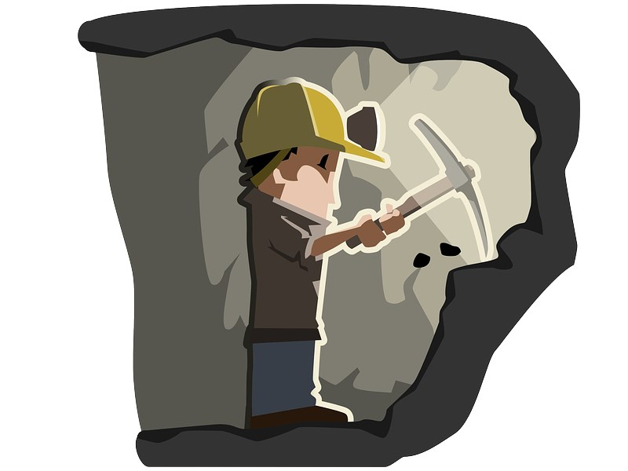


Solo Mining vs. Pool Mining
Proof of work mining takes on two forms:
Pool mining
Solo mining

Slide 20
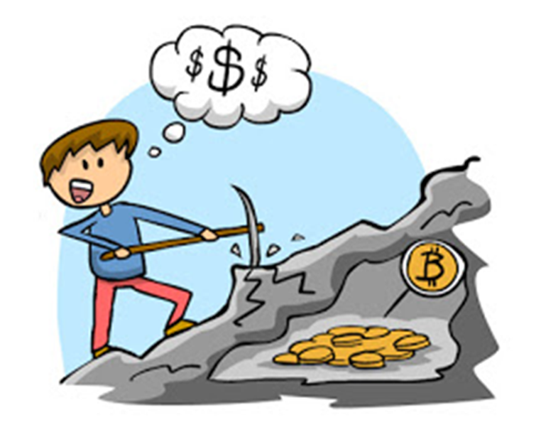
What is Solo Mining?
Solo miners have a low probability to "find" a block
Do not share the block reward
Do not pay fees to a pool
Solo miners can run a single CPU / GPU or a large farm
Works well early after a PoW cryptocurrency is launched

Slide 21
Solo Mining is Like a Lottery!
Extremely low chance to find a block, see an example:
Bitcoin block #487465 (09/2017)
Network difficulty = 1103400932964.29 ≈ 1.1034 x 10¹²
Expected number of hashes to find a block ≈ 1.1034 x 10¹² x 2³² ≈ 4.74 x 10²¹
Typical ASIC miner power ≈ 14 TH/s ≈ 1.4 x 10¹³ hashes/sec
Average time to find a block ≈ 4.74 x 10²¹ / 1.4 x 10¹³ ≈ ≈ 338 505 066 seconds ≈ 94 029 hours ≈ 3 917 days = 10.7 years

Slide 22

Mining in a Pool is More Predictable
It could take years for slower miners to mine a block
What is a mining pool?
Miners share their processing power over a network
Pools split the reward between the miners
Pools take a pool fee from the miners
In Jan 2018 the Antpool mines ~ 25 blocks / day
Recall that ~ 144 new Bitcoin blocks are mined per day

Slide 23
Bitcoin Solo vs. Pool Mining
Solo Bitcoin mining workflow
Block headers & targets
Block template
TXs
P2P Network
bitcoind
Mining Software
ASIC
Headers below target
Blocks
Blocks
Pool-Based Bitcoin mining workflow
Block headers & targets
Prototype Block
TXs
P2P Network
Mining Pool
Mining Software
ASIC
Headers below target
Blocks
Shares

Slide 24

Mining Pool Methods
Pay-per-Share (PPS)
Instant, guaranteed payout for each share, solved by a miner
Proportional
Miners earn shares until the pool finds a block
After that each user gets reward
Bitcoin Pooled mining (BPM)
Older shares from the beginning of a block round are given less weight than more recent shares

Slide 25

Mining Pool Methods (2)
Pay-per-last-N-shares (PPLNS)
Reward calculated on a basis of N last shares, instead of all shares for the last round
Geometric Method
Similar to BPM: score granted for every new share
Double Geometric Method
Generalized version of Geometric and PPLNS methods

Slide 26
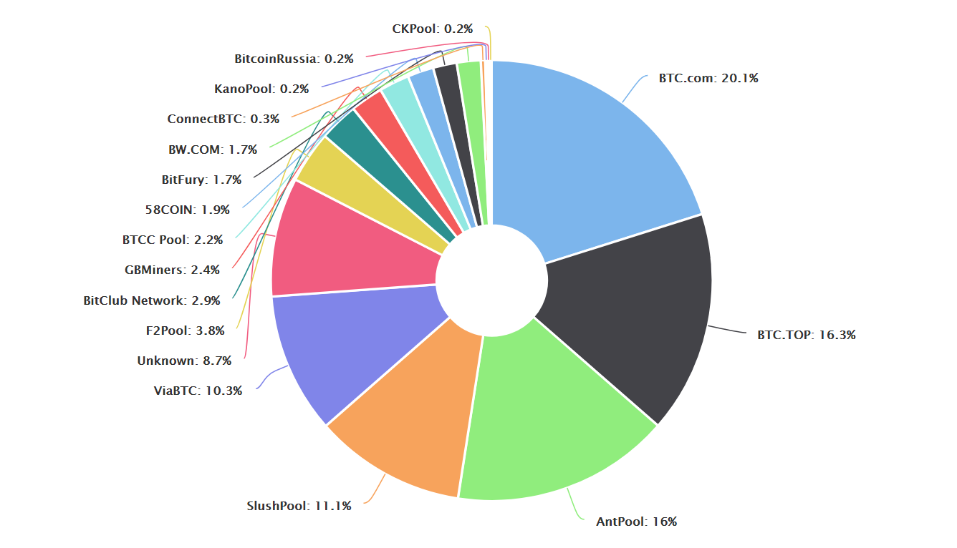
Bitcoin Mining Pools
Source: https://blockchain.info/pools (Jan 2018)

Slide 27
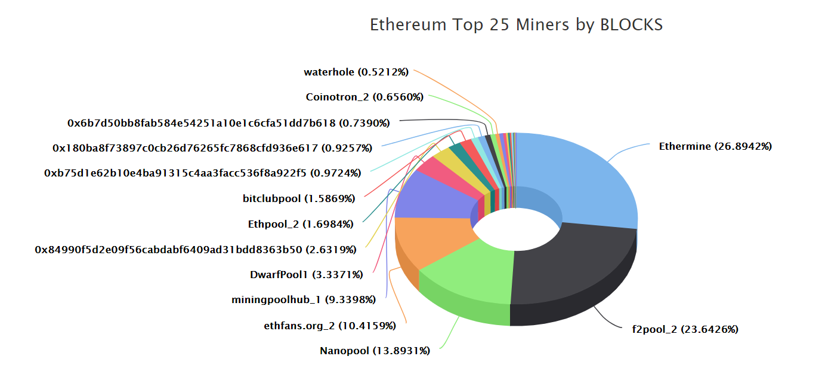
Ethereum Mining Pools
Source: https://etherscan.io/stat/miner (Jan 2018)

Slide 28
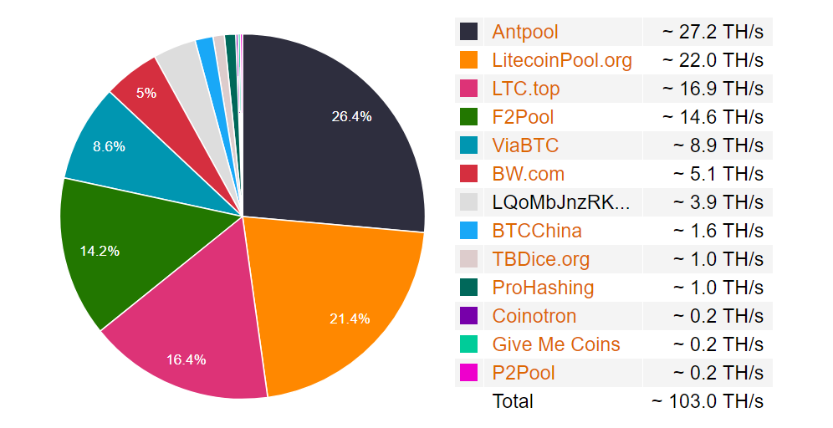
Litecoin Mining Pools
Source: https://www.litecoinpool.org/pools (Jan 2018)

Slide 29
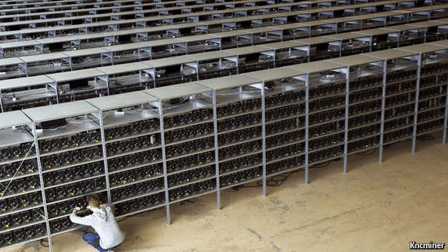
Mining: from Enthusiasts to Giant Enterprises

Slide 30
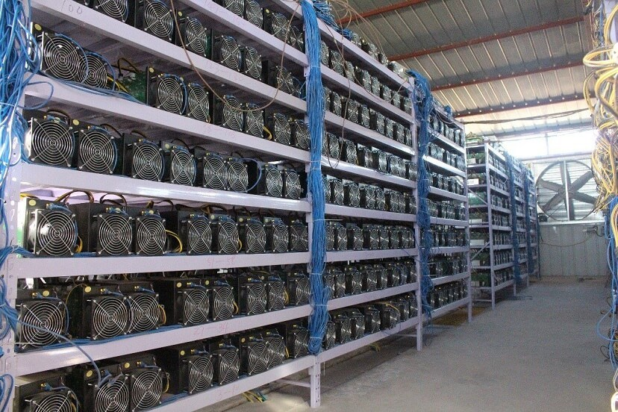
Why the Mining Farms are So Popular?
Crypto mining has become a more specialized activity
Industry invented faster Bitcoin mining equipment like FPGAs and ASICs
Mining become more profitable

Slide 31
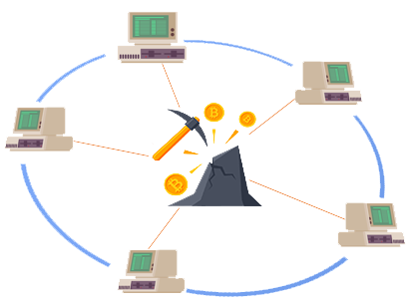
Exercise: Mine Ethereum in a Pool

Slide 32
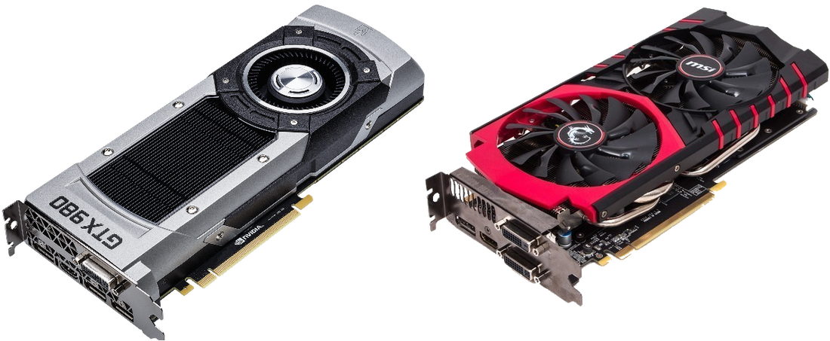

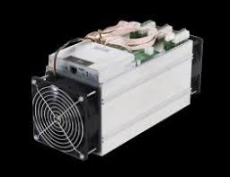
Mining Equipment
CPU, GPU, ASIC

Slide 33
Mining Equipment
Different equipment's is more effective with different PoW algorithms
GPU
CPU
ASIC

Slide 34
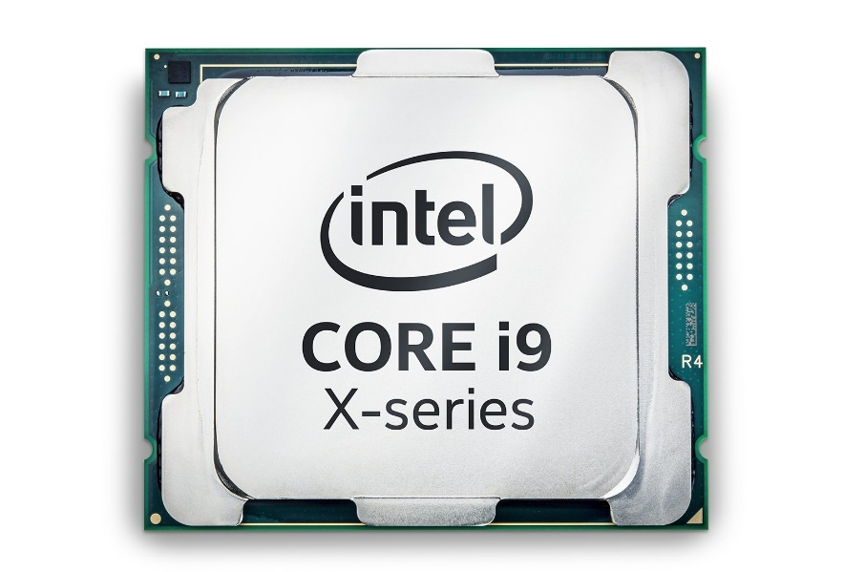
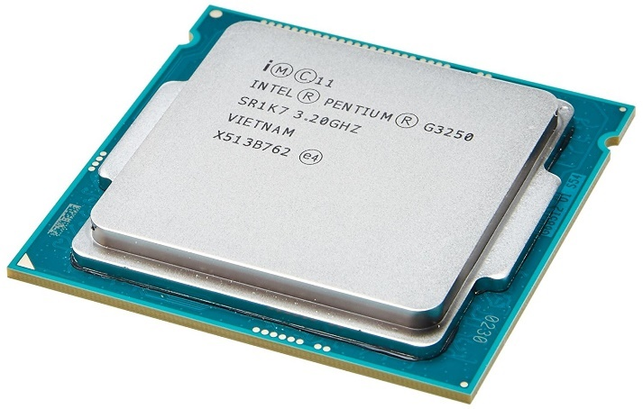
Central Processing Unit (CPU)
In the beginning, mining with a CPU was the only way to mine
Very inefficient for most algorithms
Some coins (like Monero) using CryptoNight and X11 can be mined using CPU

Slide 35
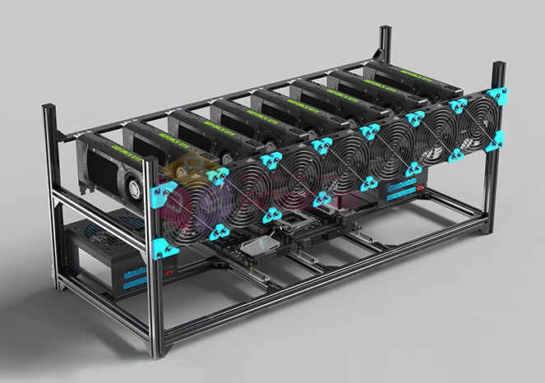
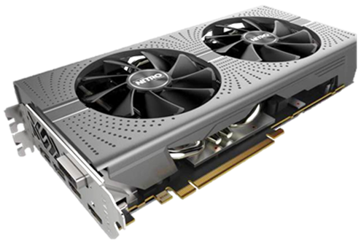
Graphics Processing Unit (GPU)
GPU rigs can mine many hashing algorithms
Ethereum miners mostly use GPUs
Some GPUs are hard to find

Slide 36
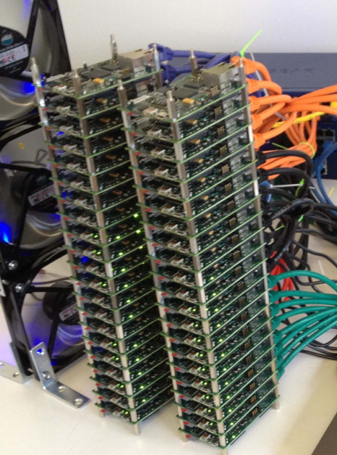
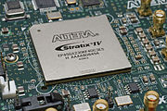
Field-Programmable Gate Arrays – FPGA
FPGA can implement complex digital computations
Field-programmable integrated circuit
Array of programmable logic blocks
Allows to build your own specialized CPU
First mining farms were based on FPGA
FPGA miners used much less power than CPU's or GPU's

Slide 37
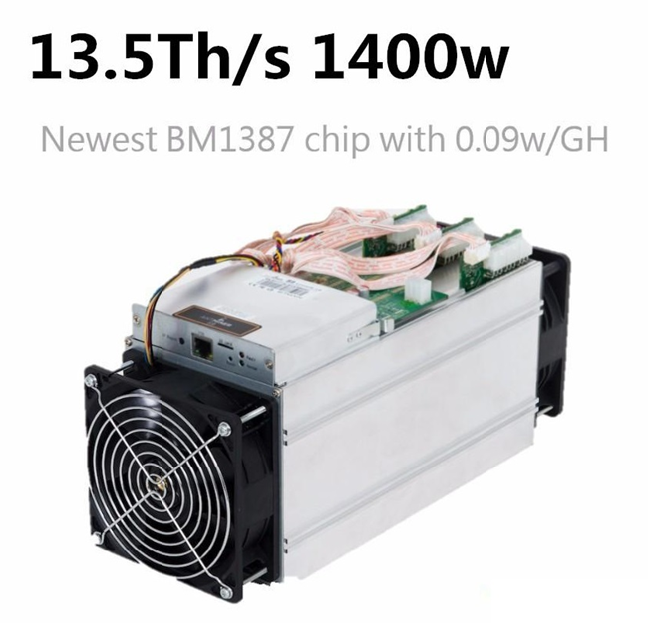
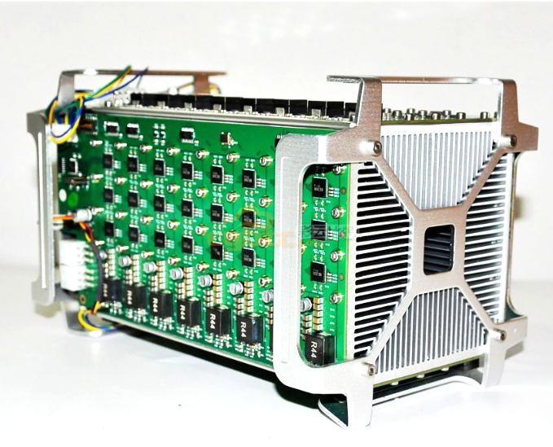
Application-Specific Integrated Circuit (ASIC)
ASIC miners are an integrated circuits customized particularly for mining
Hardware designed for mining
Very powerful
Effective with less algorithms

Slide 38
What to Mine?
Miners often switch what cryptocurrency to mine
Depending mostly on the profitability
Many sites and apps can estimate the mining expenses, expected incomes and profitability, e.g.
whattomine.com
cryptocompare.com/mining/calculator
cryptoground.com/mining-calculators

Slide 39
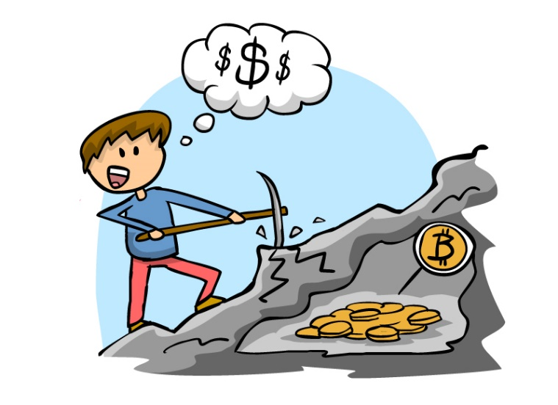
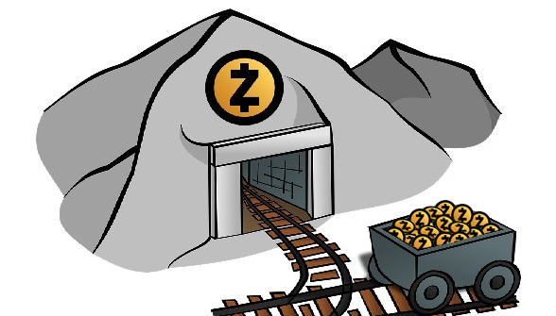
Exercise: What to Mine?
Play with whattomine.com

Slide 40

Summary
Miners calculate hashes with different nonce till find enough zeroes
Difficulty → the number of zeroes in the beginning of the target
Growing number of miners raises the network difficulty
Mining goes to giant enterprises mining farms
Solo miner has a low probability to "find" a block
Do not share the reward
Pools split the reward between theirs members
Different equipment is effective in different hash algorithms

Slide 41
Mining Process and Mining Pools
http://www.kingsland.academy

Slide 42
Resources
Bitcoin Mining: https://bitcoin.org, https://en.bitcoin.it/wiki/, https://www.weusecoins.com/en/mining-guide/
Ethereum Mining https://www.ethereum.org/
Proof of Work: https://en.bitcoin.it/wiki/Proof_of_work, https://www.cryptocoinsnews.com/proof-of-work/
Mining Pool Methods: https://en.bitcoin.it/wiki/Comparison_of_mining_pools
Mining components compare: https://whattomine.com/

